Slide 1
Course Name: Database Management System
Course Code: CS116
Dr. Praveen Kantha

Slide 2
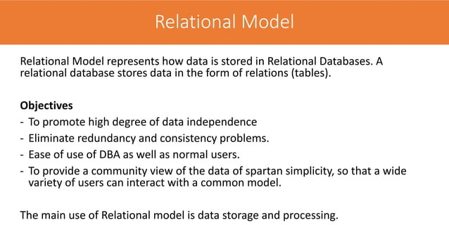

Slide 3
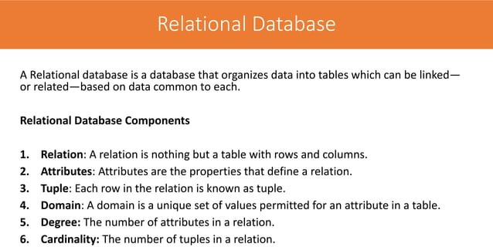

Slide 4
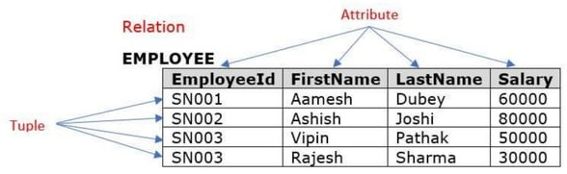

Slide 5
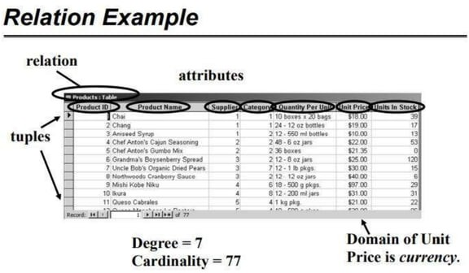

Slide 6
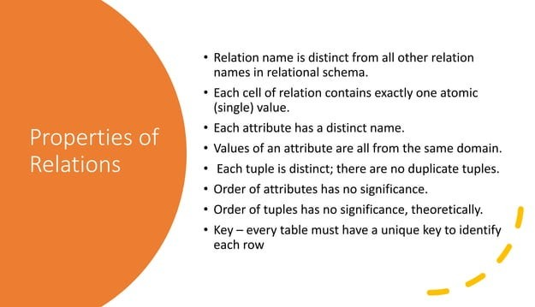

Slide 7
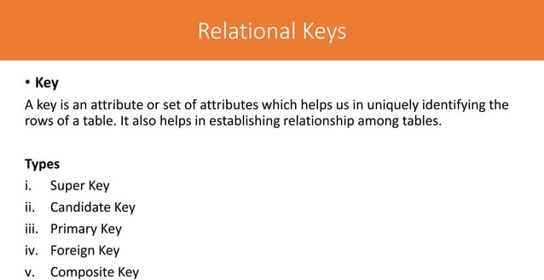

Slide 8
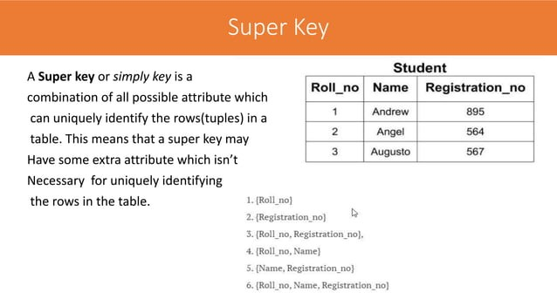
Super key superset of all combinations so we further make the candidate key or primary key from the super key.
A table can have many Super keys.

Slide 9
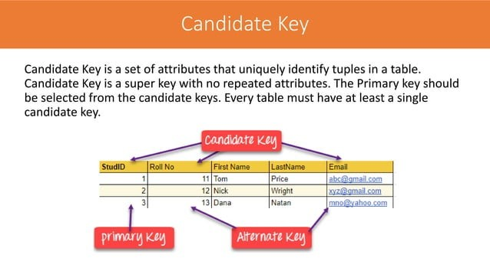

Slide 10
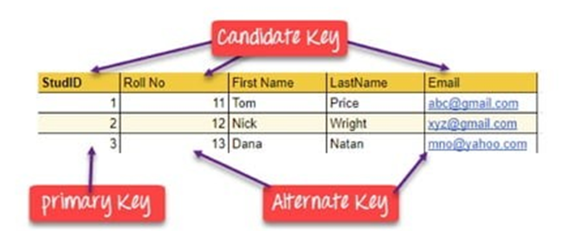
It is called a minimal super key because we select a candidate key from a set of super keys.
From the candidate key, we have to make the primary key.
{StudID) – This can be candidate key because it is uniquely identified.
{Roll No} -This can be a candidate key because it is uniquely identified.
{Email} - This can be a candidate key because it is uniquely identified.
{First Name} - This can’t be a candidate key because it is not uniquely identified.
{StudID, Roll No} -This can’t be a candidate key because it’s a minimal subset that will {StudID} and {Roll No}. As we know {StudID} already candidate key so the combination of this key is not eligible for the candidate key.
Final we have candidate key : {StudID},{Roll No} and {Email}

Slide 11
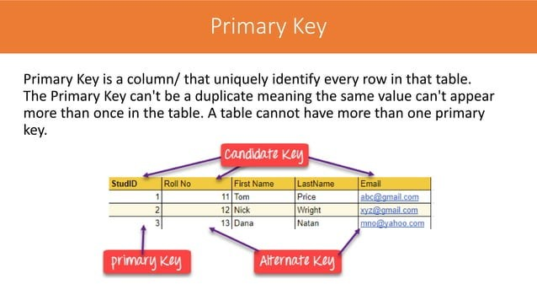

Slide 12
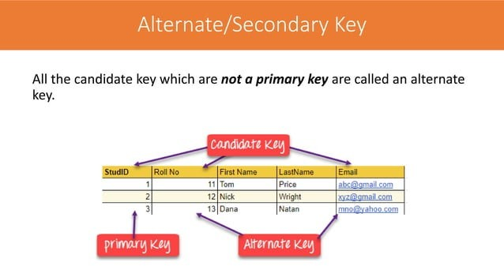

Slide 13
Final we have candidate key : {StudID}, {Roll No} and {Email}
Out of all the candidate keys, only one gets selected as the primary key, the remaining keys are known as alternate keys.
In this table:
{StudID} is best suited for the primary key.
The rest of attributes {Roll No} and {Email} are considered alternate keys
Final we have alternate keys : {Roll No} and {Email}

Slide 14
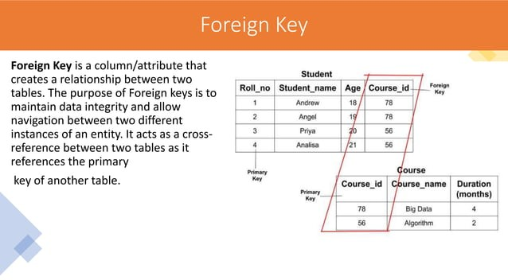

Slide 15
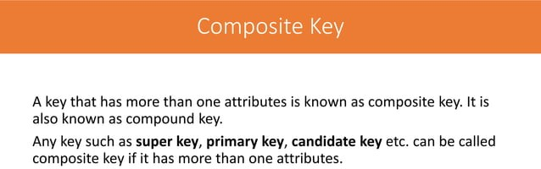

Slide 16
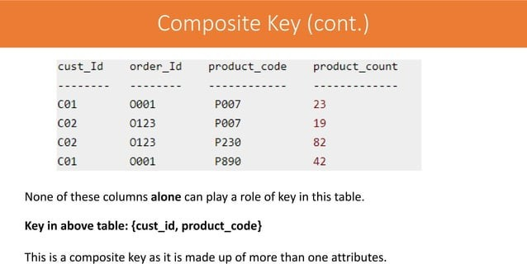

Slide 17
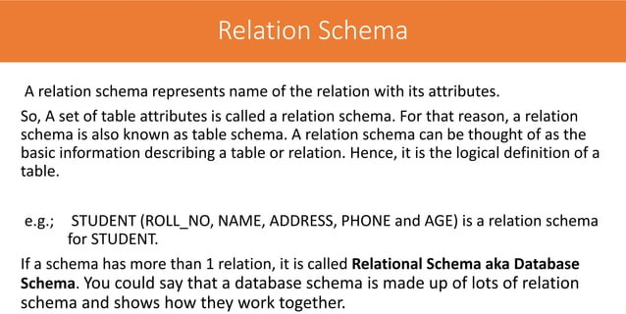

Slide 18
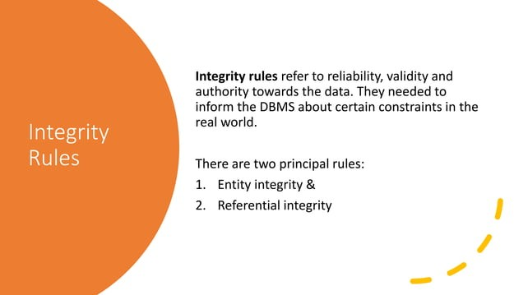

Slide 19
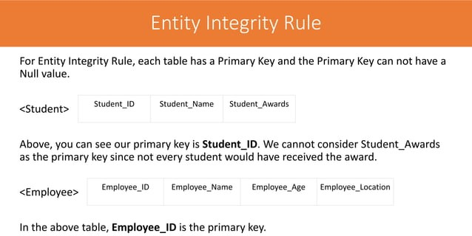

Slide 20
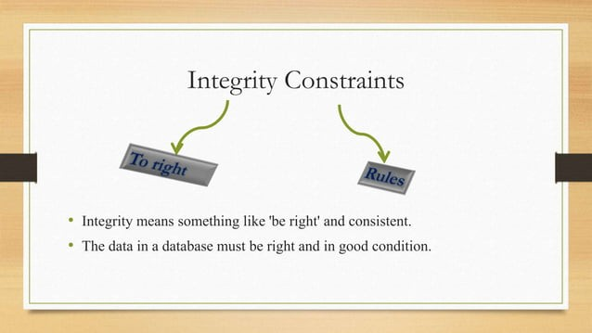

Slide 21
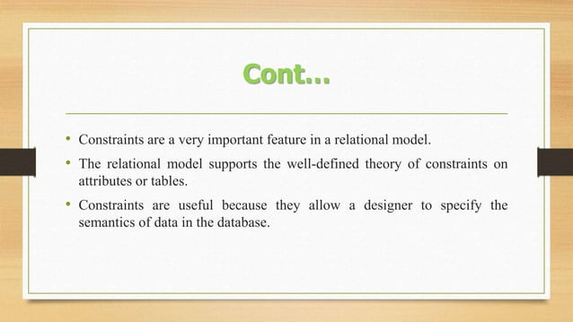

Slide 22
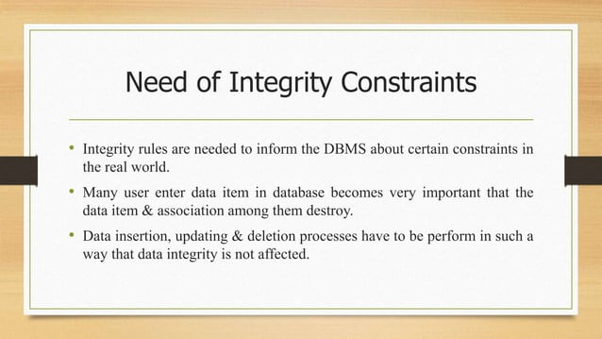

Slide 23
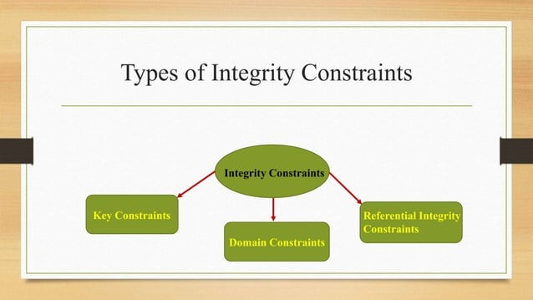

Slide 24
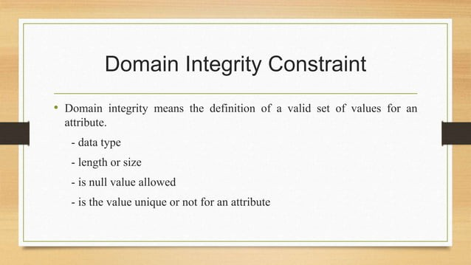

Slide 25
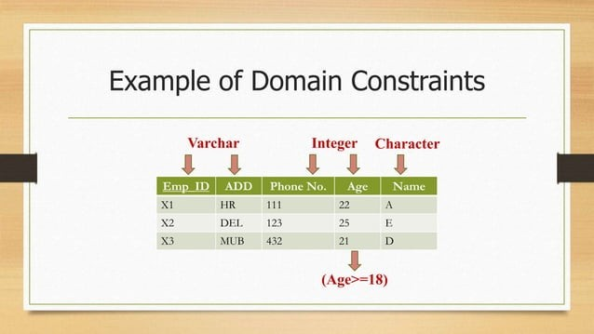

Slide 26
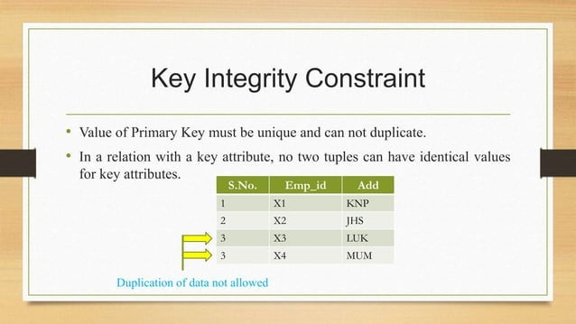

Slide 27
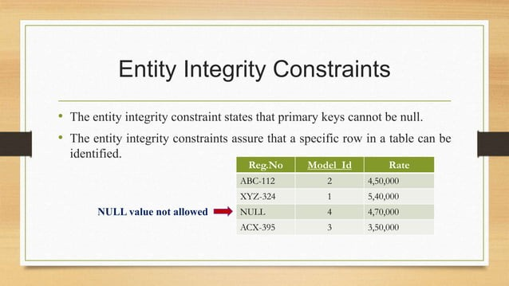

Slide 28
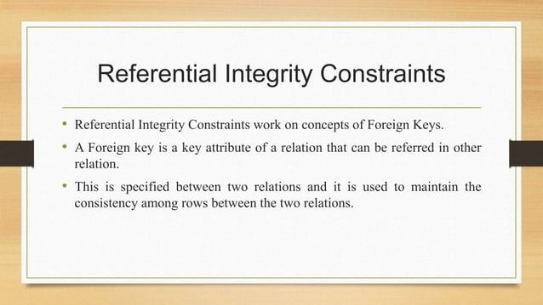

Slide 29
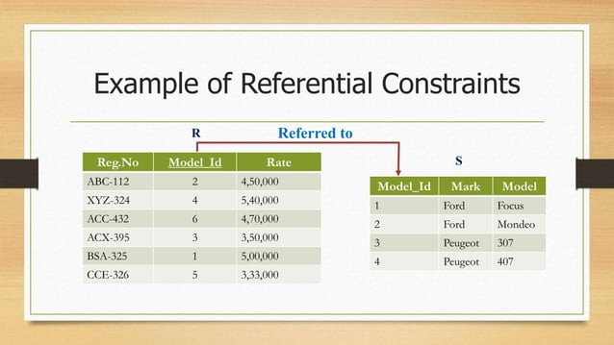

Slide 30


